Slide 1
WELCOME
START GAME
HOW TO PLAY

Slide 2
INSTRUCTIONS
Split the class into two teams, and one-by-one you will represent your team.
Choose your answer.
If it’s correct, your team gets 2 points.
If it’s incorrect, the other team can steal for 1 point.
To move to the next question click the DNA strand.
Double Jeopardy- collaborate with your team mates and present an answer with the points you want to wager.
A final 5 point bonus question will be up for grabs!!
The team with the most points wins the game.
START GAME

Slide 3
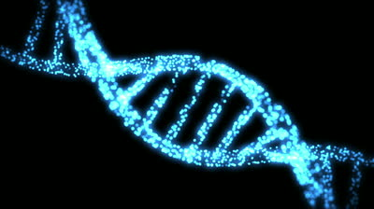
INCORRECT

Slide 4
CORRECT !!!

Slide 5
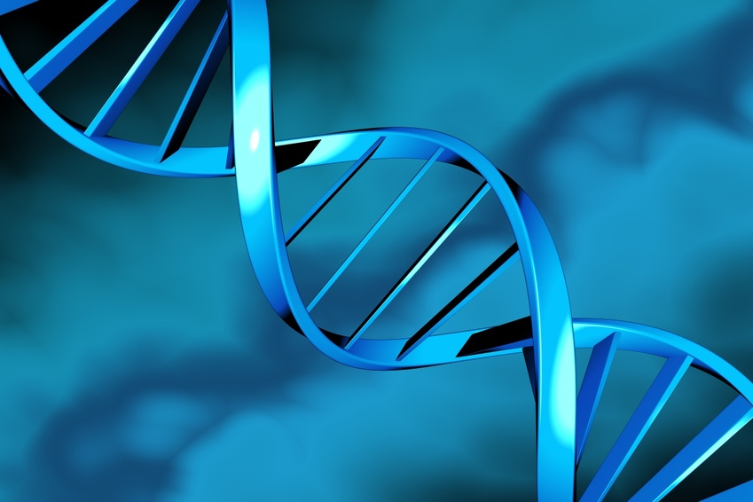
QUESTION 1
What is the complementary base to T?
A
T
C
G
U

Slide 6
CORRECT !!!

Slide 7
QUESTION 2
If one strand of DNA has the sequence ATGCGA, what would the complementary strand look like?
TCAGCTC
ATCGCT
UACGCU
TAGCGT
TACGCT

Slide 8
CORRECT !!!

Slide 9
QUESTION 3
Which of the following is not a component of a nucleotide?
Ribose sugar
Nitrogenous base
Deoxyribose sugar
Phosphate
Hydrogen bond

Slide 10
CORRECT !!!

Slide 11
QUESTION 4
What is the complementary base of A?
U
A
C
G
T

Slide 12
CORRECT !!!

Slide 13
QUESTION 5
Which of the following is not a pyrimidine?
Cytosine
Guanine
Uracil
Thymine

Slide 14
CORRECT !!!

Slide 15
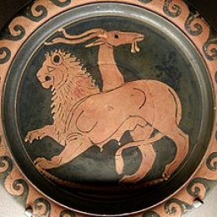
Double Jeopardy
Chimeras are mythical creatures that are made up of different animal parts – a lion head, goat body and snake tail.
Is it possible for humans to have more than one type of DNA? Explain.
Answer

Slide 16
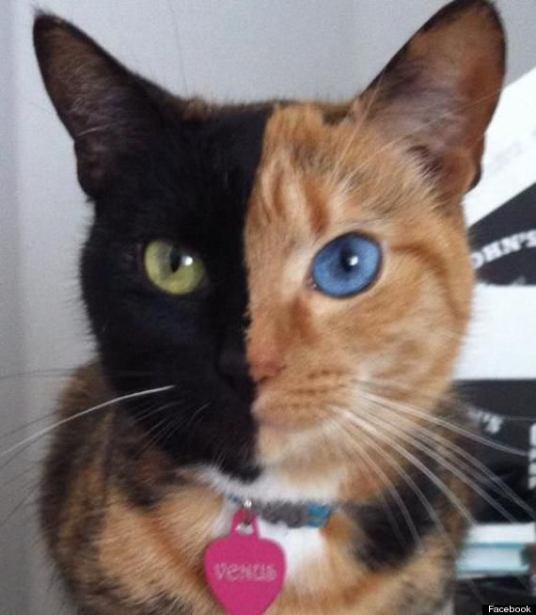
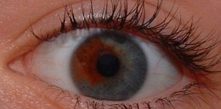
Double Jeopardy
It is possible!
Often times not visible externally, and can lead to issues with organ transplants or parental cases.
If it does occur it is more likely to happen with twins, ex. blood can be taken up in the womb.

Slide 17
QUESTION 6
Guanine is a purine. Which other base is a purine?
A
T
C
U

Slide 18
CORRECT !!!

Slide 19
QUESTION 7
How many chromosomes are in a typical,
somatic human cell?
46
23
22
48
50

Slide 20
CORRECT !!!

Slide 21
QUESTION 8
What type of bond holds together the backbone of DNA?
H Bonds
Electrostatic
Ionic
Covalent
Van der Waals

Slide 22
CORRECT !!!

Slide 23
QUESTION 9
What is G’s complementary base?
T
A
U
C
G

Slide 24
CORRECT !!!

Slide 25
Double Jeopardy
What is
3,000,000,000 bases long?
Answer

Slide 26
Double Jeopardy
Our genome.
3 billion bases equals approximately 3 gigabytes of storage. However, Harvard researchers were able to store 700 terabytes of data on a single gram of DNA.

Slide 27
QUESTION 10
What type of cell would a muscle cell be?
Gamete
Contraction
Sex
Nerve
Somatic

Slide 28
CORRECT !!!

Slide 29
QUESTION 11
Where in the body can you find haploid cells?
Liver Cell
Sperm
Fat Cell
Nerve Cell
Brain Cell

Slide 30
CORRECT !!!

Slide 31
QUESTION 12
DNA is being transcribed to RNA, which base pairs with A?
U
T
C
G

Slide 32
CORRECT !!!

Slide 33
QUESTION 13
What would be the complementary base of C?
C
G
U
T
A

Slide 34
CORRECT !!!

Slide 35
Double Jeopardy
Humans age because our DNA accumulates damage. Are there any animals that have evolved mechanisms to evade aging? Explain and provide an example.
Answer

Slide 36
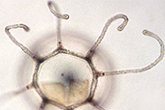
Double Jeopardy
When some jelly fish age they revert back a young juvenile stage.
Lobsters have also extended their telomerase enzyme to continue working past adolescence when ours stops.

Slide 37
QUESTION 14
What is the main difference between RNA and DNA?
RNA is double stranded
RNA has the base T
DNA is single stranded
DNA has the base U
RNA is single stranded

Slide 38
CORRECT !!!

Slide 39
QUESTION 15
DNA strands run…
Parallel
Antiparallel
Perpendicular
Linearly
Conservatively

Slide 40
CORRECT !!!

Slide 41
BONUS ROUND

Slide 42
BONUS QUESTION
Who discovered the double
Helix structure of DNA?
Marie Curie
Watson & Crick
Gregor Mendel
Charles Darwin
Rosaland Frankin

Slide 43
CORRECT !!!

