Slide 1
Introduction to Mendelian Genetics
SBI 3U

Slide 2
Learning Goals
By the end of the class students will be able to:
Understand how genes affect physical traits
Understand dominant and recessive genes
Understand complete dominance, partial dominance, and co-dominance in gene expression
Understand how to use a Punnett Square to determine offspring

Slide 3
The Code of Life
A gene is a section of DNA that encodes for a trait.
Living things have two copies of each gene, one from each parent
A phenotype is the observable, physical trait the gene encodes for
Each gene can have different versions called alleles
Different combinations of alleles can lead to different phenotypes
A genotype is the combination of alleles
A homozygote has 2 copies of the same allele
A heterozygote has 1 copy of 2 different alleles

Slide 4
Allele Types
Alleles can either be dominant or recessive
Dominant alleles: these alleles code for physical traits that are expressed in heterozygotes
Recessive alleles: these alleles code for physical traits that are usually not expressed in the phenotype, except under rare circumstances

Slide 5
Genotypic Shorthand
Genes are assigned a letter.
Capital letters are for dominant alleles
Lowercase letters are for recessive alleles
Ex.
TT has 2 copies of a dominant allele (T)
Dd has 1 copy of both a dominant (D) and recessive allele (d)
hh has 2 copies of a recessive allele (h)
Gender is a special case and uses X and Y.

Slide 6
Complete Dominance
The dominant gene overpowers the recessive gene and expresses its trait in the heterozygote
Dark hair in humans follows this pattern
Genotype | DD | Dd | dd
Phenotype | Dark Hair | Dark Hair | Light Hair

Slide 7
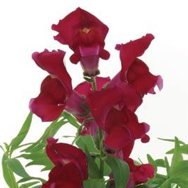
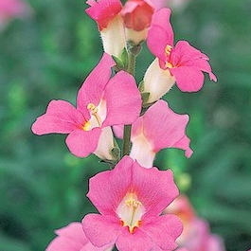
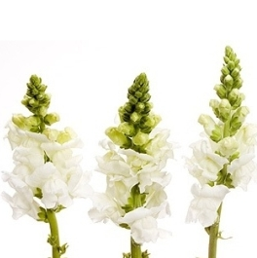
Incomplete Dominance
The dominant gene partially overpowers the recessive gene and an intermediate trait is seen
Colour in snapdragon flowers follows this pattern
Genotype | RR | Rr | rr
Phenotype | Red Flowers | Pink Flowers | White Flowers

Slide 8
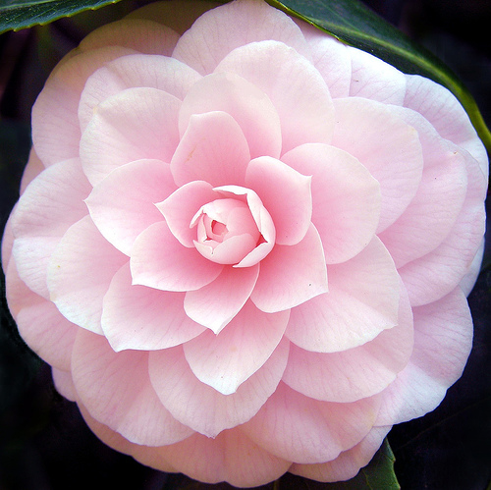
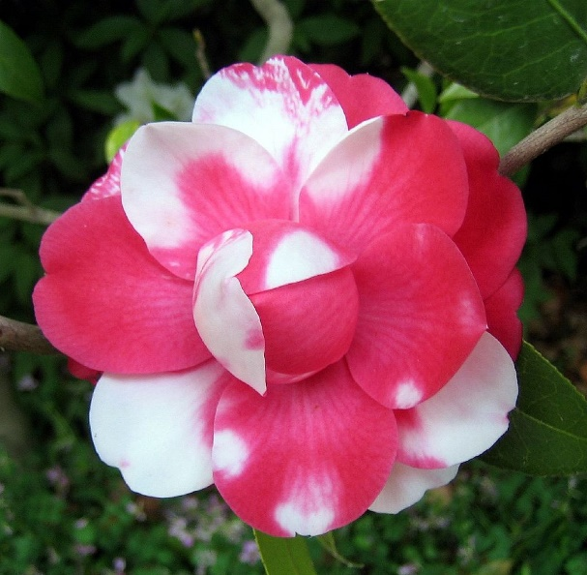
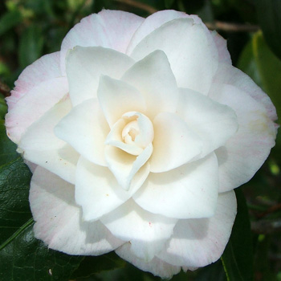
Co-dominance
Both alleles cannot hold dominance over each other, thus both alleles are seen in the heterozygous form
Colour in certain Camellia flowers follow this pattern
Genotype | PP | Pp | pp
Phenotype | Pink Flowers | Pink and White Flowers | White Flowers

Slide 9
Punnett Squares
Cross RR & Rr
Punnett Squares are used to determine offspring genotypes
How to use:
1: Make a 3x3 Table with the top-left missing
2 : Split the parents genotype and put each allele in a row or column
3: cross the rows and columns to get the offspring genotypes
Rr
R
r
R
RR
Rr
RR
R
RR
Rr

Slide 10
Reading Punnett Squares
All offspring squares in the Punnett square have an equal likelihood of occurring.
2/4 or 50% chance of offspring being RR
2/4 or 50% chance of offspring being Rr
R
r
R
RR
Rr
R
RR
Rr

Slide 11
Learning Goals
By now students should be able to:
Understand how genes affect physical traits
Understand dominant and recessive genes
Understand complete dominance, partial dominance, and co-dominance in gene expression
Understand how to use a Punnett Square to determine offspring
If not, then now is a good time to ask questions!

