Slide 1
A Princess Story
-AT Family Words

Slide 2
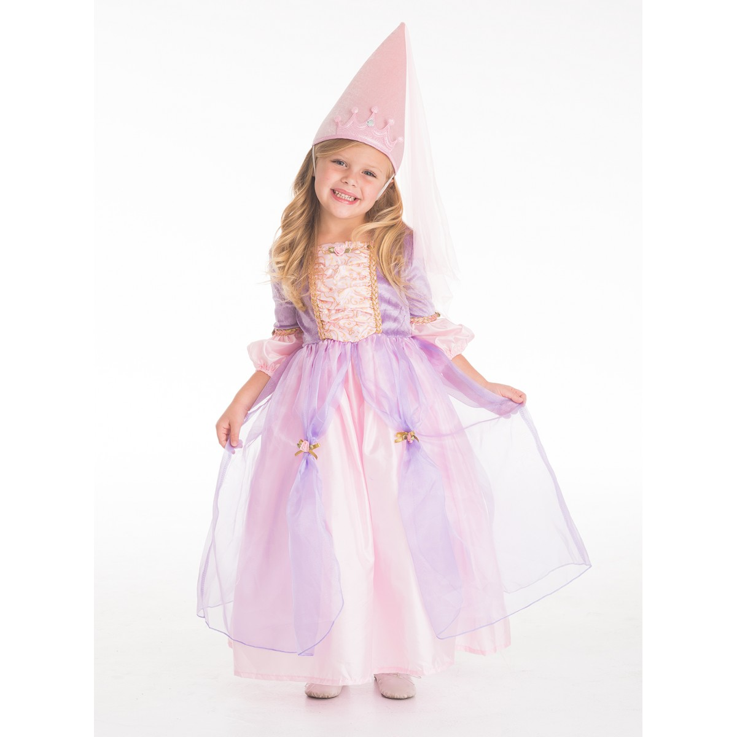
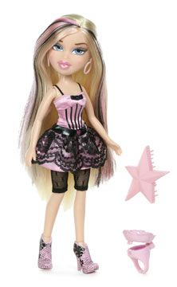
Once upon a time,...there was a Princess named Brat.

Slide 3
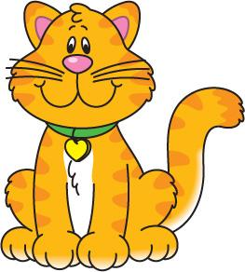
She lived in a big castle with her best friend Pat.

Slide 4
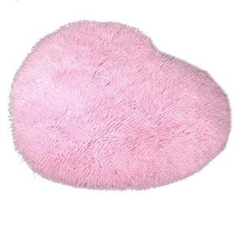
Brat and Pat they sat on a comfy mat.

Slide 5
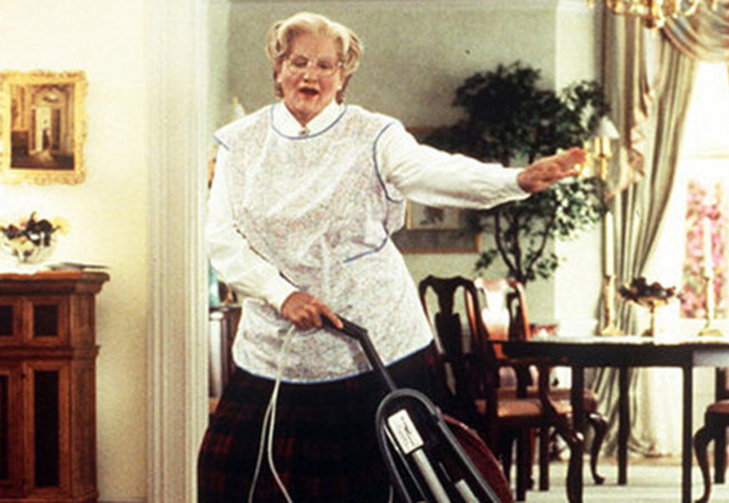
Her Fat Nanny wanted to chat, chat, chat.

Slide 6
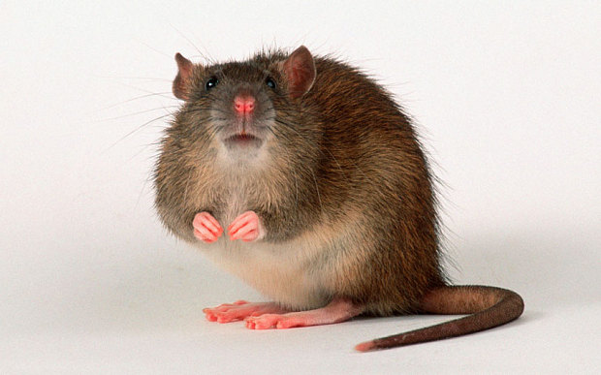
Suddenly, the cat smelled the scent of a smelly old rat.

Slide 7
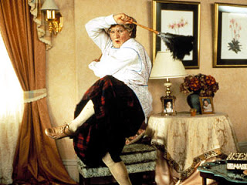
Brat got scared and yelled, “Nanny get that big fat bat!”

Slide 8
That is next to the pink fluffy mat.

Slide 9
Nanny asked Brat to step outside, “don’t forget your hat, hat, hat!”

Slide 10
As Brat and Pat went outside they both heard a big SPLAT!

Slide 11
“Oh no, goodbye poor Rat”

Slide 12
Finally, the Fat Nanny, Brat and the Cat lived happily ever after with no fear of smelly old Rat.

Slide 13
The end

