Slide 1
Life in the Trenches of WWI
1914-1918

Slide 2
Learning Goals
By the end of this lesson, students will…
Select and organize relevant evidence and information on aspects of Canadian history since 1914 from a variety of primary and secondary sources ensuring that their sources reflect multiple perspectives
Interpret and analyze evidence and information relevant to their investigations, using various tools, strategies, and approaches appropriate for historical inquiry
Use appropriate terminology when communicating the results of their investigations
Identify some major developments in science and/or technology during this period, and assess their significance for different groups in Canada

Slide 3
Trench Routine
Since the usual time for an enemy attack was at dawn, soldiers would wake then to guard the frontline trenches
If there was no attack, they would gather for inspections, breakfast, and the daily rum ration
During the day, soldiers worked in their trenches doing a numbed of chores, ranging from cleaning latrines to filling sandbags or repairing duckboards
In between chores, soldiers had time for leisure activities that included: reading, writing, or gambling
It was at night time that trench life was most dangerous as soldiers would move into No Man’s Land

Slide 4
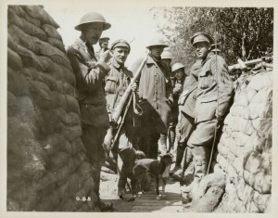

Slide 5
Trench Raids
Patrols often occurred at night under the cover of darkness; however, there was still a risk of injury, death, or capture
There was also a risk of running into enemy patrols
Raids could become miniature battles if they were carefully planned and prepared for. These miniature battles would include the coordination of the raiding party with the machine gunners and artillery
Raids kept soldiers in the trenches alert, motivated and aggressive, but they could also result in many casualties

Slide 6
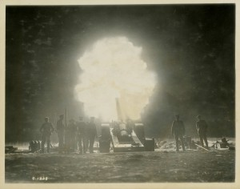

Slide 7
Trench Weapons
Trench warfare came about due to the increased firepower of machine guns, artillery, and rifles
Once soldiers had dug into their trenches, a stalemate occurred on the Western Front and the only way to break that stalemate was to create greater weapons
At the outbreak of war, most soldiers only carried a rifle and a bayonet
As the war progressed, soldiers became better equipped and began carrying grenades and utilizing mortars and machine guns in addition to their rifles and bayonets
Poison gas and tanks were also used to break into and out of enemy trench lines

Slide 8
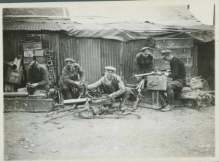

Slide 9
Trench Newspapers
Some units published their own newspapers
These newspapers were a way for soldiers to express their thoughts and feelings about the war
The newspapers contained articles, poetry, jokes, and cartoons
These newspapers were censored by the military, but they were a safe environment for soldiers to reveal their anger about their hard life, although this was often done through the use of jokes
There were over 30 different Canadian trench newspapers during WWI and only few copies remain

Slide 10
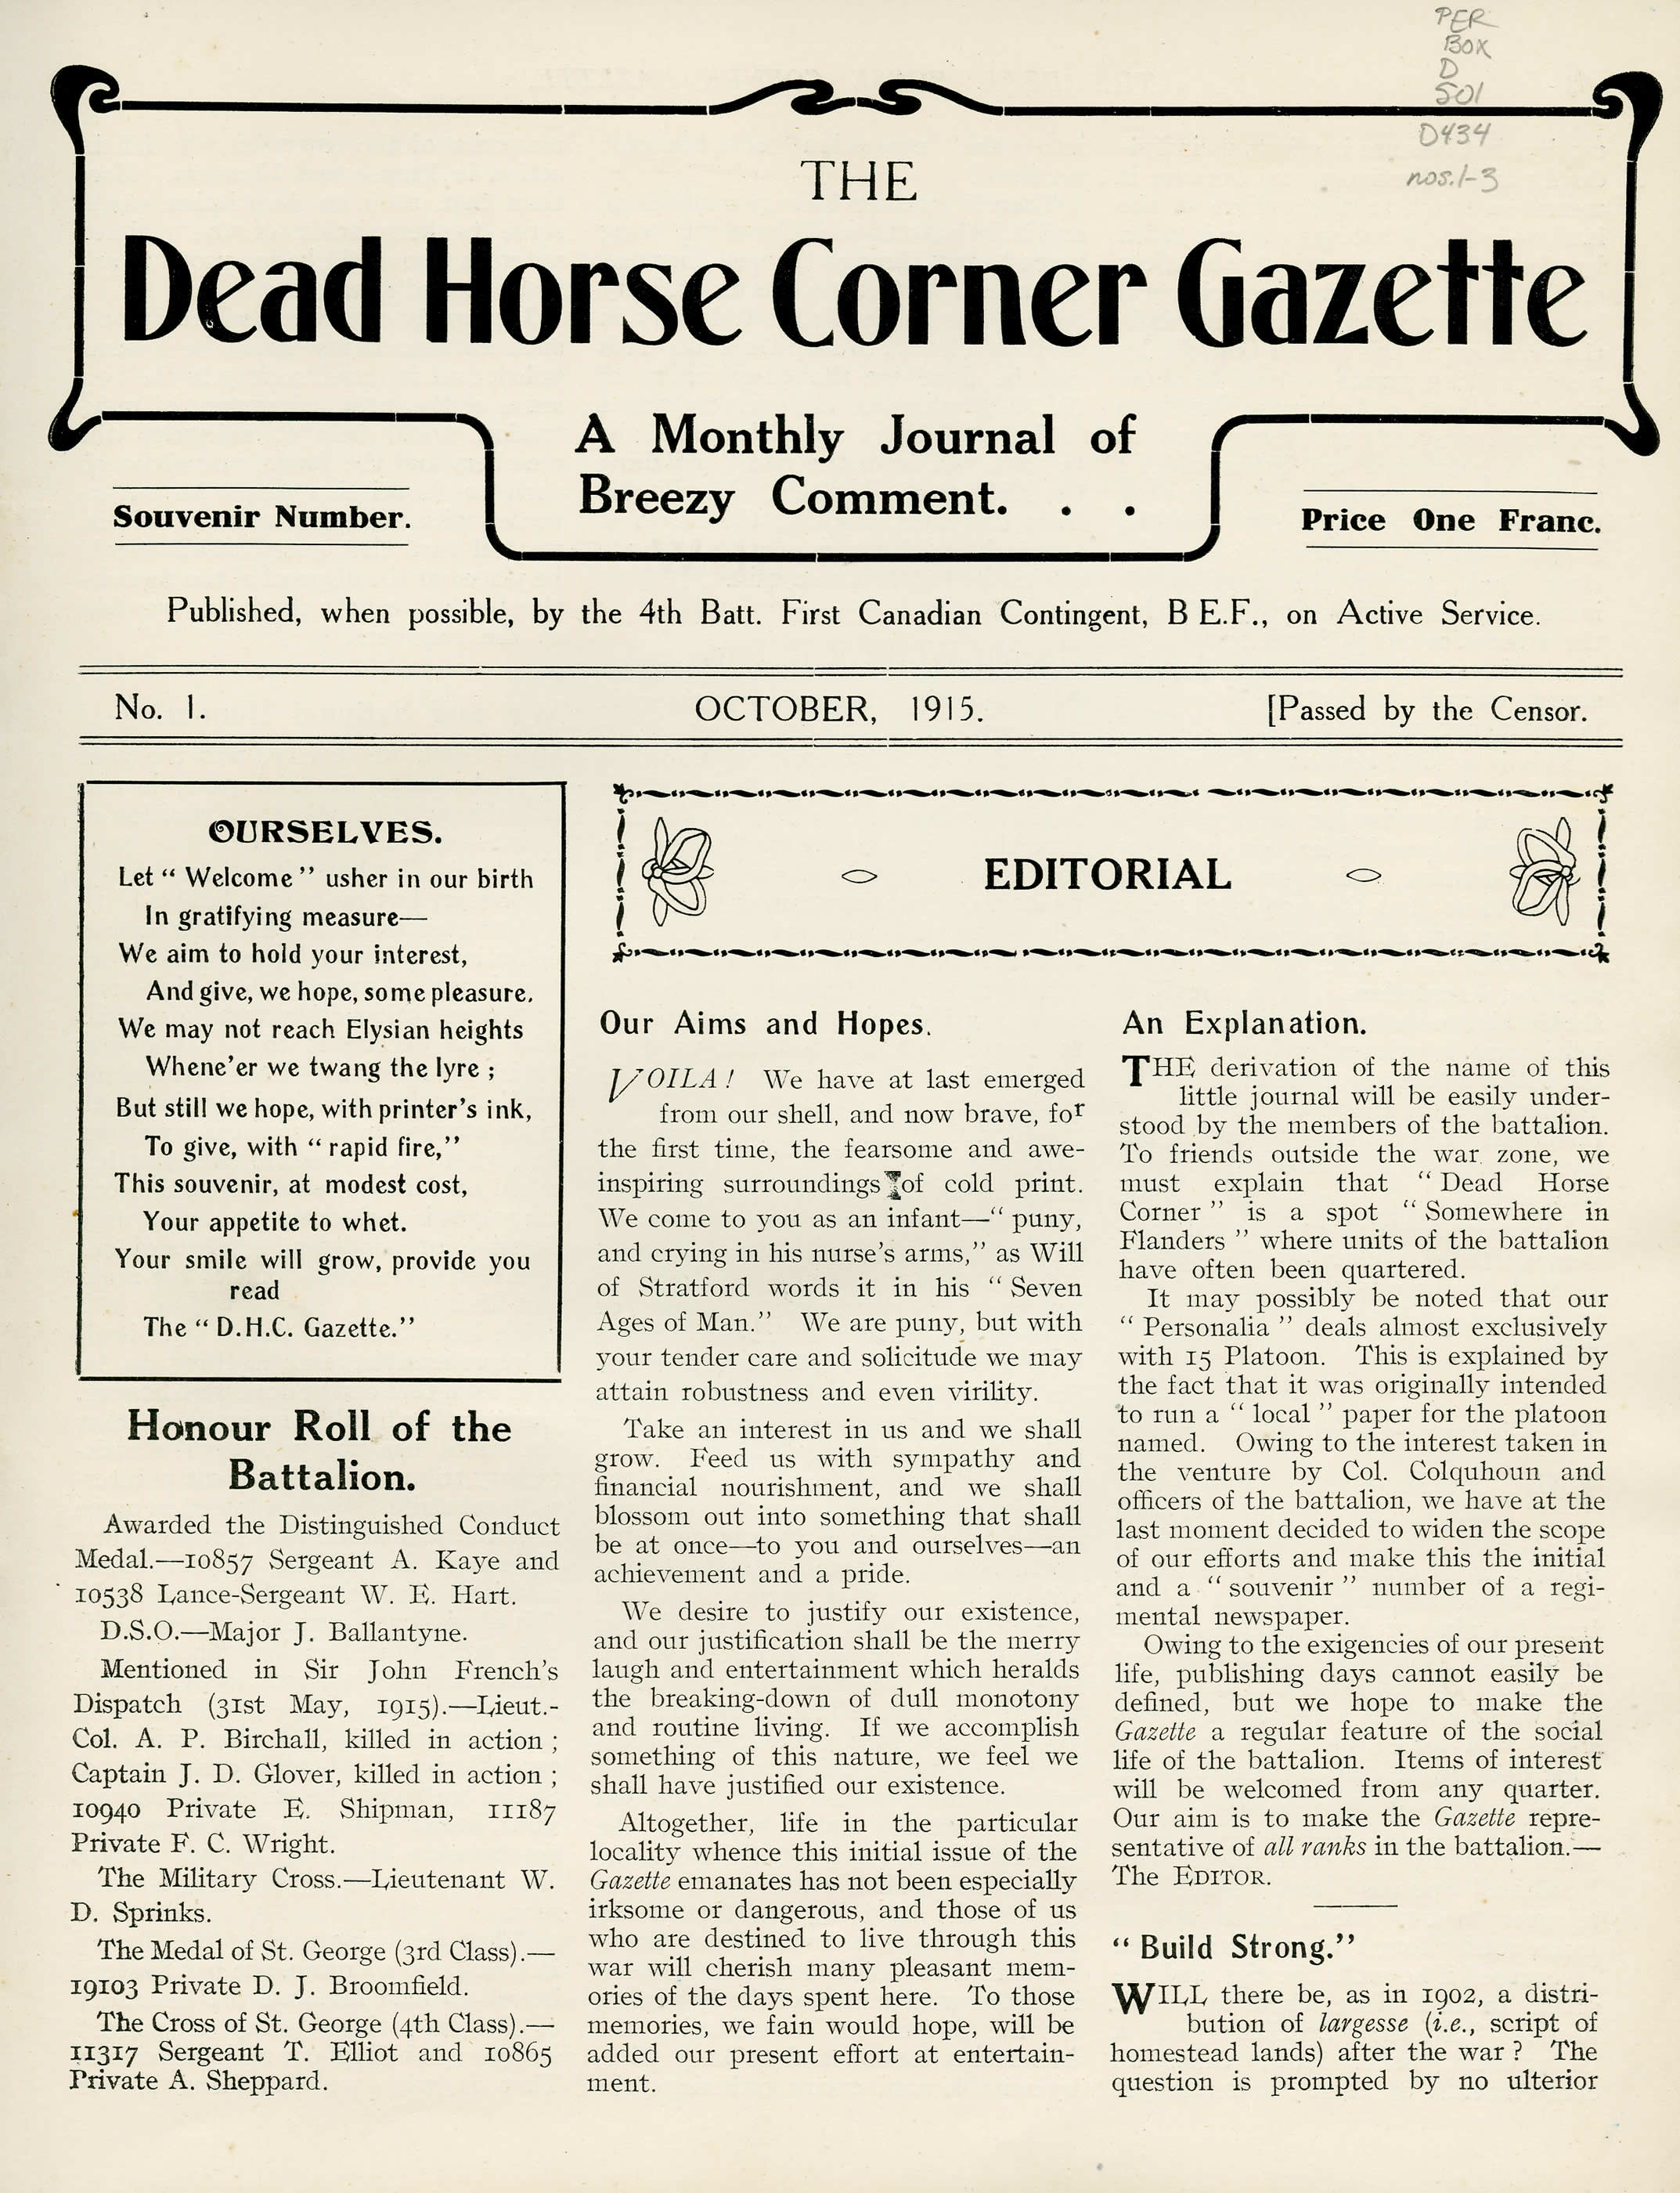
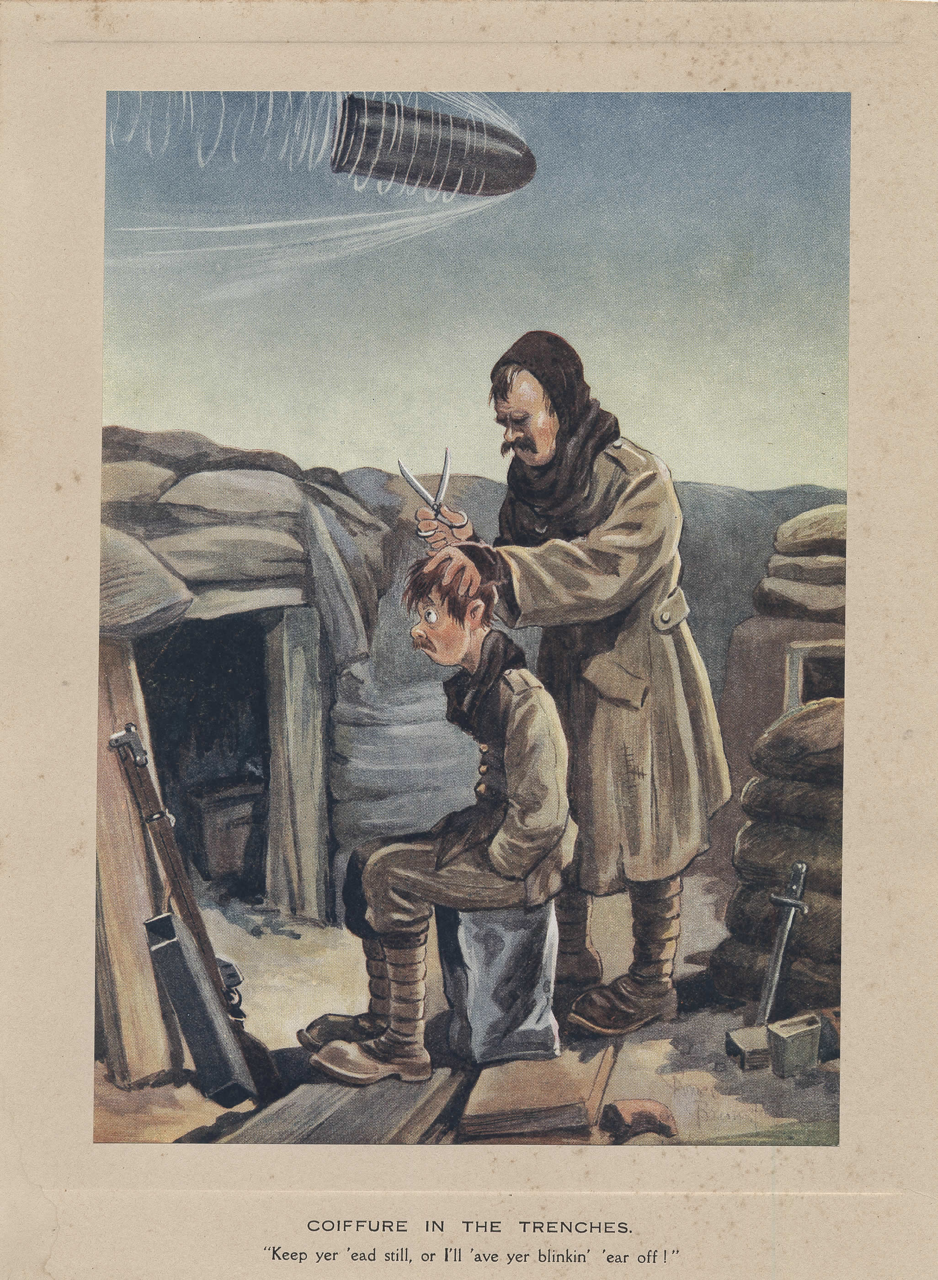

Slide 11
Rest and Leisure
Soldiers rotated into and out of the front lines to provide a break from the stress of combat
Soldiers spent 4 to 6 days in the front trenches before moving back and spending an equal number of days in the secondary trenches and, finally, the reserve trenches
Soldiers could go on an occasional leave to England
The YMCA hut was the centre of a soldier’s social life where they could read and write during the day, and attend concerts or lectures in the evening
Sports also relieved the stress of war – baseball was the most popular

Slide 12
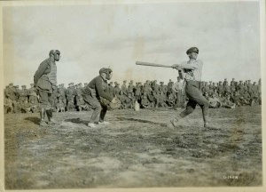

Slide 13
Pests and Pain
Rats and lice infested the trenches and contributed to the spreading of diseases among soldiers
Lice was found to be the cause of Trench Fever, which included headaches, fevers, and muscle pain
The unsanitary conditions in combination with the cold weather and persistent dampness resulted in Trench Foot
Trench Foot was a frostbite-like infection and in extreme cases led to gangrene and amputation

Slide 14
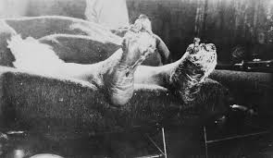
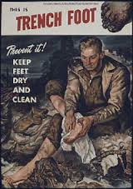

Slide 15
Maintaining Morale
Bonds of friendship, loyalty and community based on shared experience and common dangers promoted a strong sense of group identity
Training, firm discipline, and strong leadership motivated soldiers
The threat of punishment kept soldiers in line
Shared sense in the justice of their cause
The military attempted to provide simple pleasures like cigarettes
Letters arrived from home daily and on occasion care packages were sent as well
Rum was used for reward, medicine and motivation

Slide 16
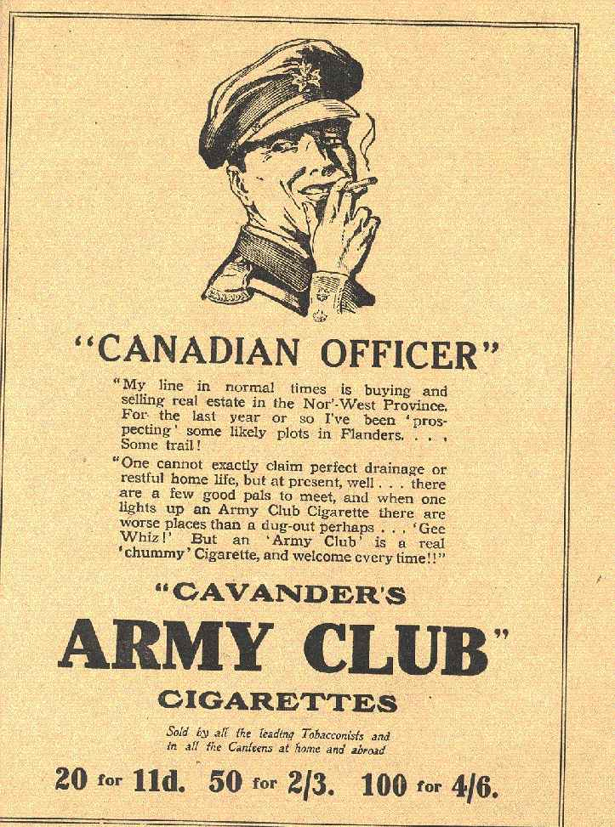
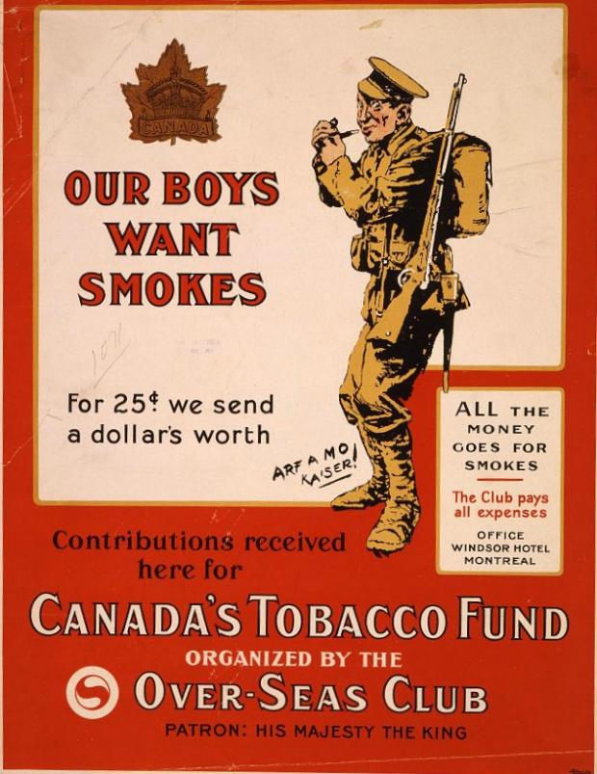

Slide 17
Escaping the Trenches
High casualties, poor food, and lack of sleep constantly threatened to undermine the morale of soldiers in the trenches
Soldiers that suffered from excessive stress (shellshock) may turn to desertion for which the punishment could be death by firing squad
Some soldiers turned to self-inflicted wounds (SIWs) - gunshot wound to the hand or foot, rubbing chemically infected soil in one’s eyes, etc.
These soldiers with SIWs would be moved to a SIW hospital where they were liable to sentences that ranged from punishment to imprisonment
There were 729 cases of SIW in the Canadian Expeditionary Force, and many more that were likely undetected
The actual number of soldiers who tried to escape trench life through illegal actions was small

Slide 18
